Slide 1

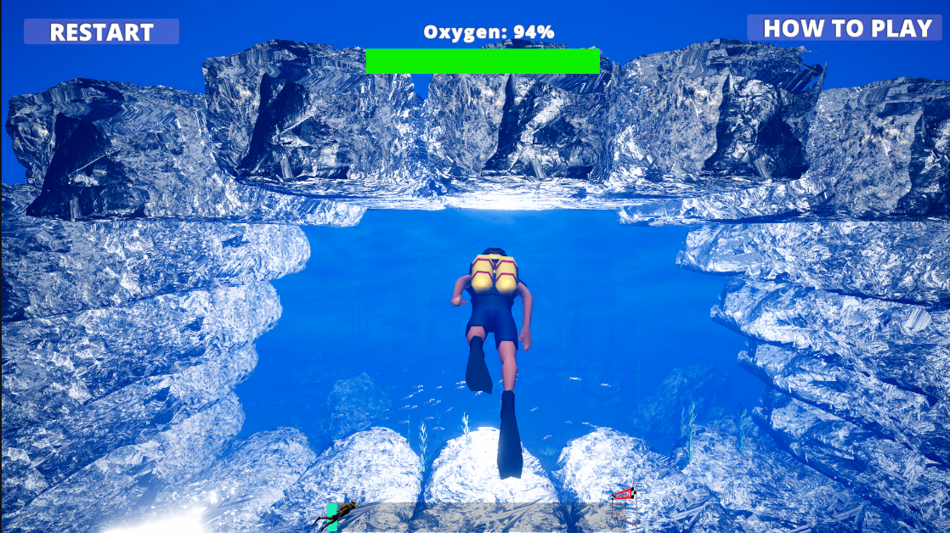

Aqua
Guardian
Adi Nahmias 315260505
Matan Adar 209321553
Hod Wyszkin 322401605
Project Advisor:
Dr. Erel Segal-Halevi

Slide 2
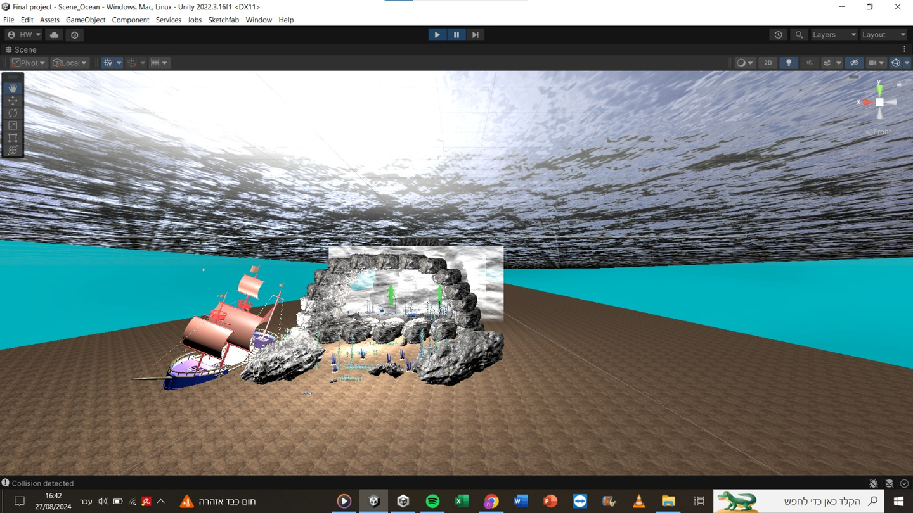
Problem Description
Our project deals with stroke patients with impaired hand movement.
Current exercises and games are not interesting, which leads to low motivation.
We aimed to create a more engaging game to enhance recovery and enjoyment.

Slide 3
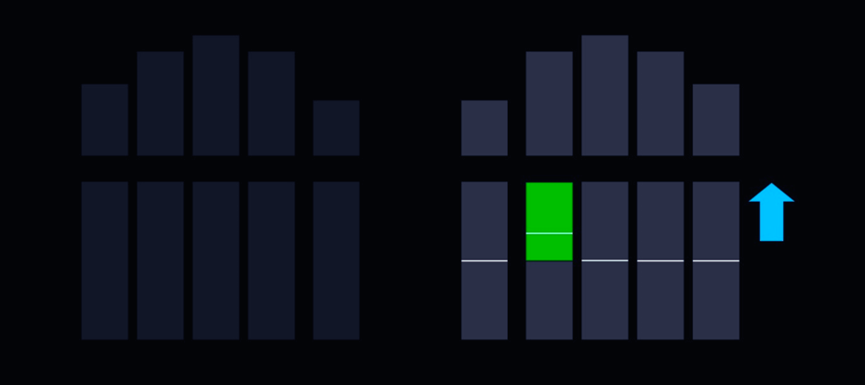
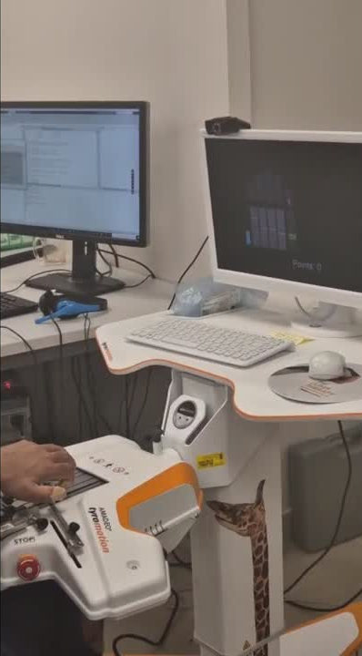
Current State
The current rehabilitative game at Beit Loewenstein uses the Amadeo device to visually track and reflect patients' finger movements to encourage hand rehabilitation exercises.

Slide 4
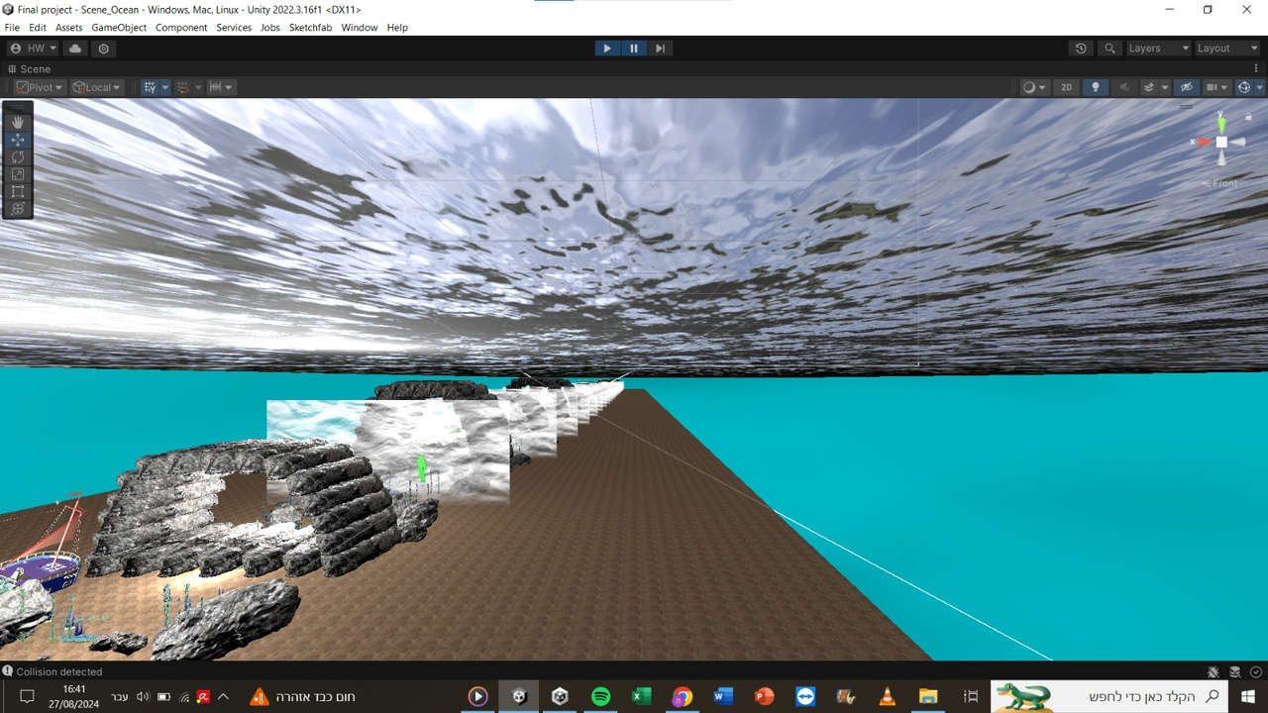
We wanted to create a game to increase the level of motivation among patients.
Created a custom game for stroke patients that adjusts the difficulty based on finger strength detection.
Project Objectives

Slide 5
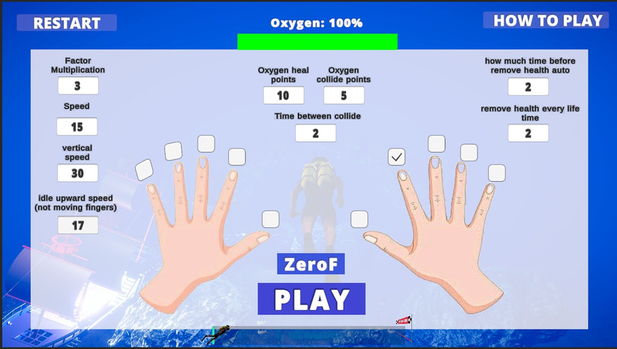
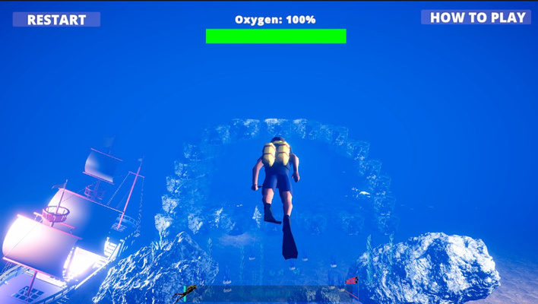
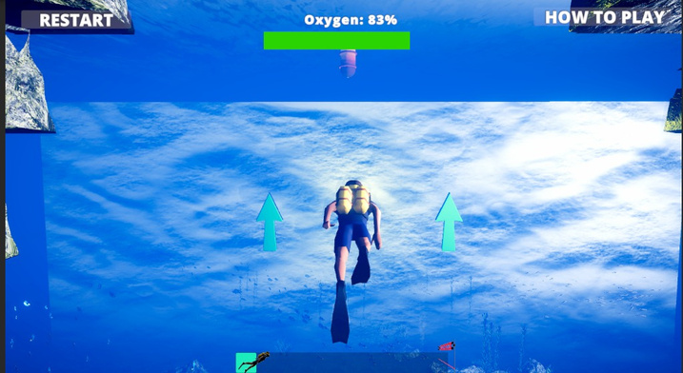
Gameplay
Mechanics
First, we adapt the game to the patient's abilities. The patient controls a diver, aiming to reach the end of a cave-filled course. Lowering their finger makes the diver dive. The diver must manage their oxygen levels and navigate obstacles to reach the treasure at the end of the course.

Slide 6
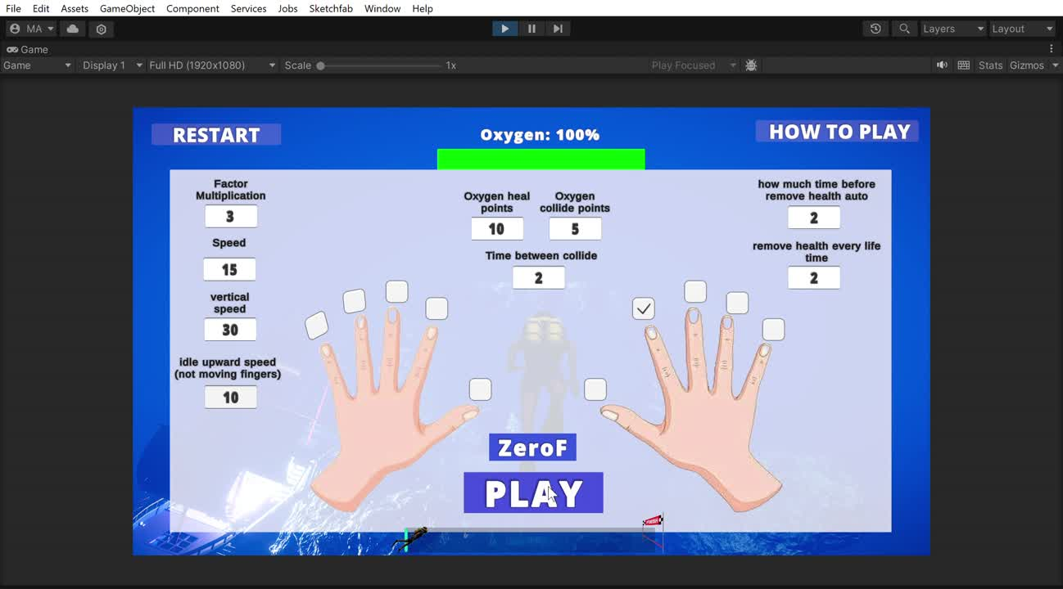

Slide 7
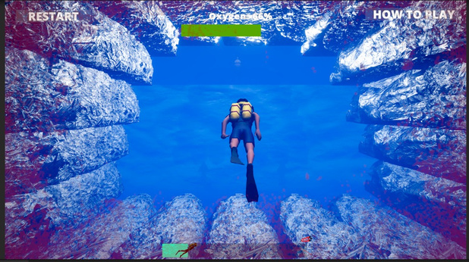
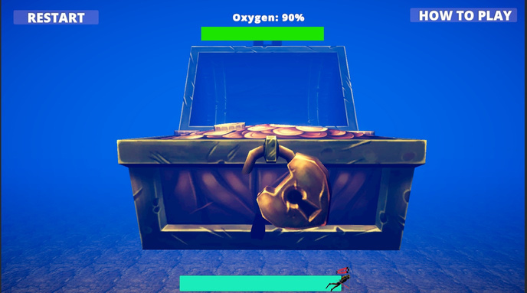
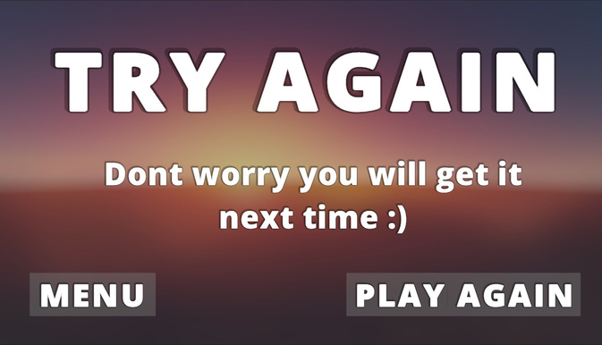
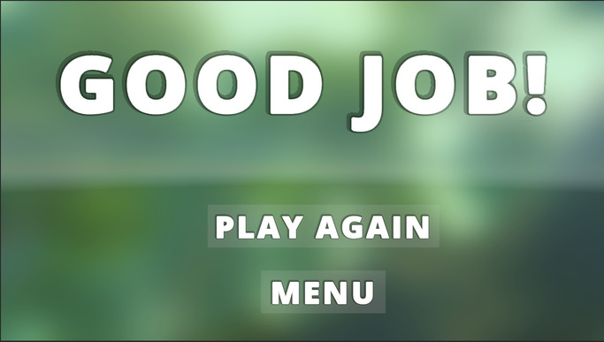
Key Dramatic and Significant Components of Our Game
Player Feedback on Success and Failure
Difficulty Levels
Focus and Engagement
The game customizes difficulty with cave size, diver speed, and oxygen depletion to match each patient’s abilities.
The project enhances finger movement and motivation with an immersive ocean-themed game featuring dynamic visuals and progress tracking.
Audio and visual cues guide gameplay, with red flashes for collisions and sounds for successes. End-of-game screens and music reinforce outcomes.

Slide 8
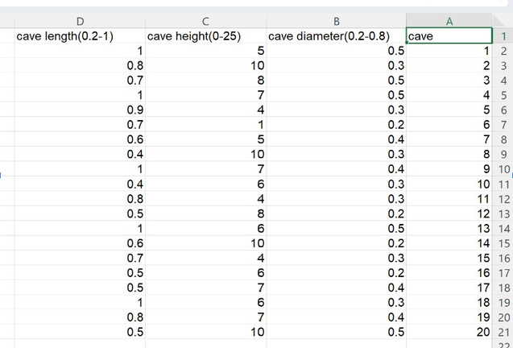
Technical
Simulation Using Demo File
Explanations
Force Data Integration via UDP
Cave Parameters from Excel File
Basic Game Parameters GUI

Slide 9
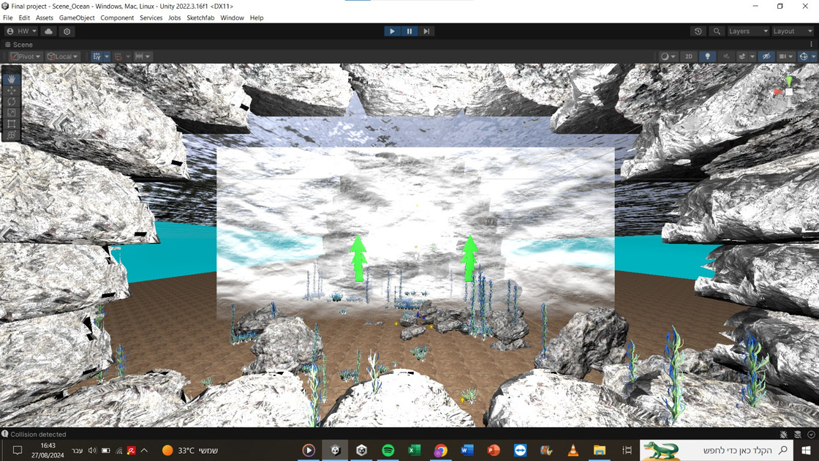
Experimentation
Participant Selection
Initial Setup and Testing
Adapting the game to the patient
Feedback

Slide 10
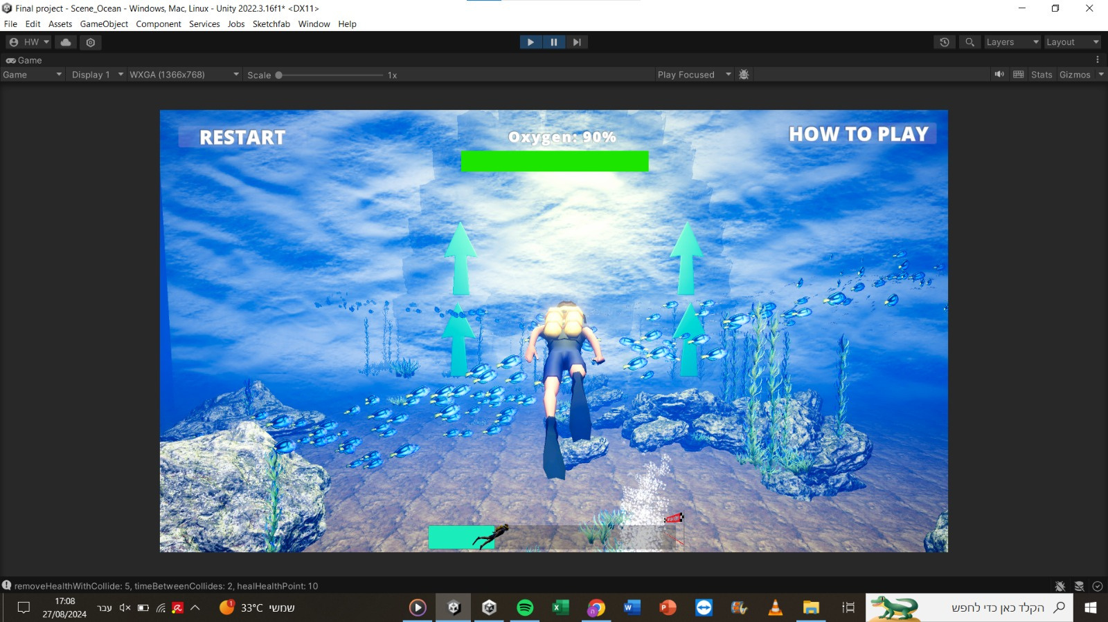
Impressions from the Doctor
Dr. Shay was pleased with the ability to adjust the game dynamically, and estimated that the patients' performance improves and so does the motivation to succeed.

Slide 11
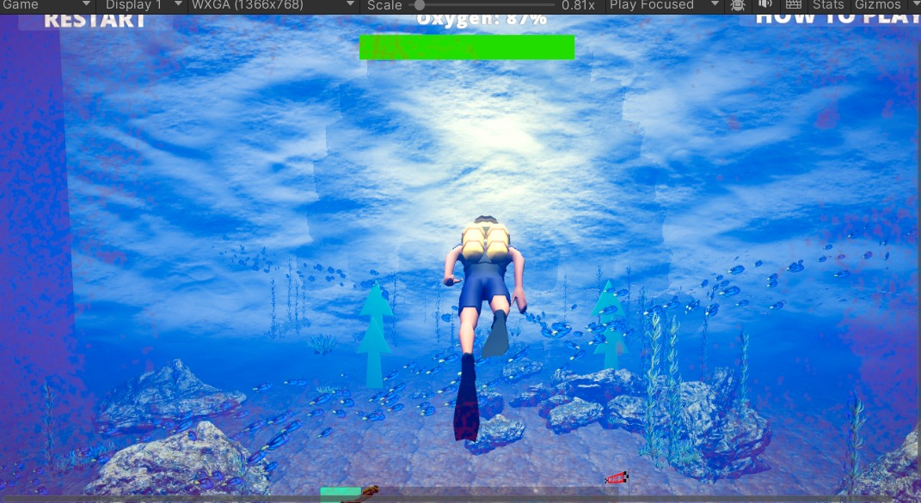
Feedback and Responses from Patients
Participant 1 - a male in his 50s
found our game realistic and engaging, appreciating its visuals and ease of understanding. He preferred it over the existing game for its continuous challenge and motivational elements, noting he could play longer without stress.
Participant 2 - a male in his 70s
preferred our game for its ease of use, focusing on one finger at a time, and enjoyed its sound and visuals, allowing him to play longer compared to the existing game.
Participant 3 - a 13-year-old
enjoyed our game more than the existing one, appreciating its visuals and challenge, and was able to play longer while feeling an improvement in finger movement.

Slide 12
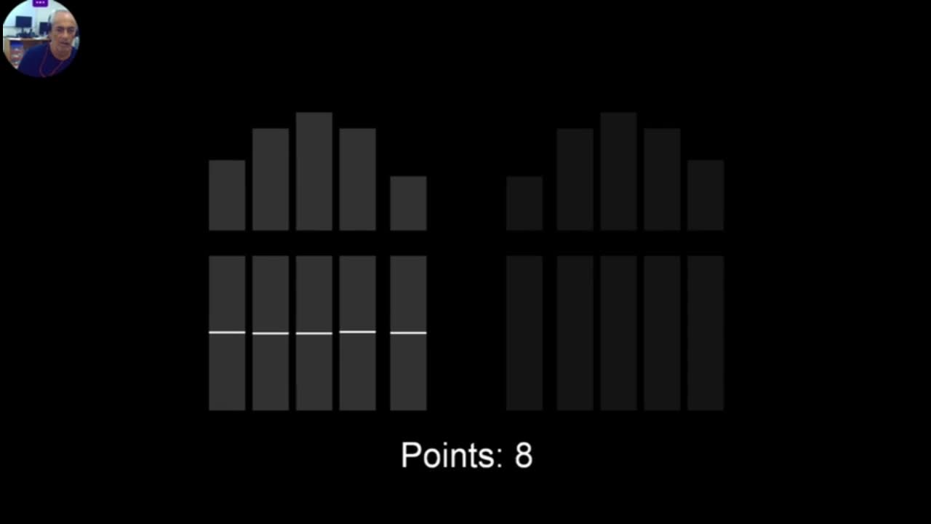

Slide 13
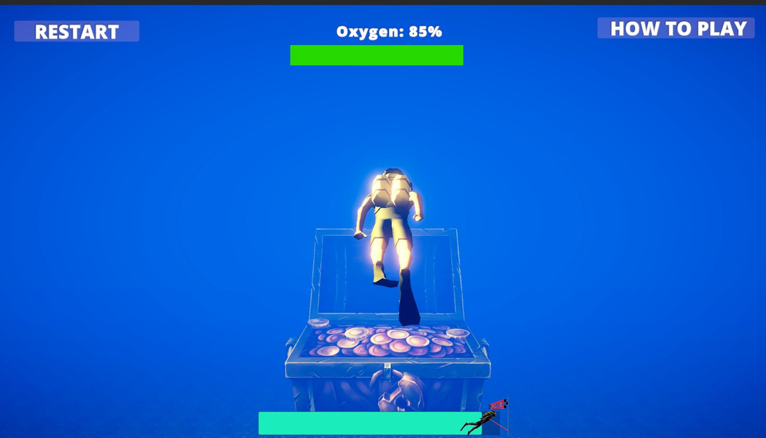
Conclusion
Patients enjoyed rehabilitation more with our game.
Positive feedback suggests the game’s potential.
We identified areas for improvement
Patients needed breaks; add a pause button.
Scoring system could motivate and track progress.

Slide 14
Thank
You.
Thank
You.
Thank
You.

